Slide 1
namespace Freddie Sackur { public interface ITalk { void SetLength(int length); string Waffle();
Notes:
Are there any software engineers here? (I might get away with this!)
Has anyone here had to work on some code that is really awful?
Has anyone here had to work on some code that is awful, but you suspect it started out OK when it was first written?
It’s more-or-less OK at the outset, isn’t it? But then it dies from a thousand cuts.

Slide 2

Software Engineering
Notes:
PAUSE
The profession of SE is primarily concerned with change.

Slide 3
Assembly code
CP, ADD, MOV, JMP, etc
No distinction between data and instructions
No type-checking
No exception mechanism
Imagine the bugs!
Notes:
History lesson!
Machine code – might be programmed with mechanical switches, punch cards, etc. Assembly language is the use of human-readable keywords to write machine code, which is then run through an assembler to assemble source files and to convert into binary machine code.
We call this the “imperative” programming paradigm – you execute a sequence of statements.

Slide 4
C
Data types and data structures
Functions - this makes it procedural in addition to being imperative
Typed - but weakly enforced
Pointers, not references - you can perform arithmetic, you may fail to initialise a pointer
Compiled - compiler checks syntax
Notes:
“Procedural” – you can define sections of code that you can invoke by name, and pass in parameters. This is a big win for readability.
Complex data types are accessed through pointers. A pointer is just a memory address. You manually allocate a chunk of memory and get back a pointer to the start of the chunk. It’s up to you what you do with it. If you want to store a string, you allocate enough memory for as many characters as you want. To get the characters in the string, you start with the pointer – which is just a number – then keep adding 8 to dereference each character. If you go past the end of the string, who knows what you’ll get?
Once you’re done with your string, you need to manually deallocate the range, or you have a memory leak.

Slide 5
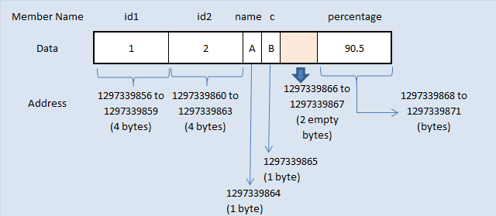
Struct
Notes:
C does not have classes and objects, but it does have structs.
A struct is a data-only object that maps fields of fixed size to offsets from a pointer. It’s a bit like an Access database record.
The start of this object is a known memory address, and the size of each field is known, so to get a field – to dereference it - you just perform arithmetic.
If our pointer is 0x0AC73800, then our first field is at 800, our second field is at 804, our third field is 808, and so on.

Slide 6
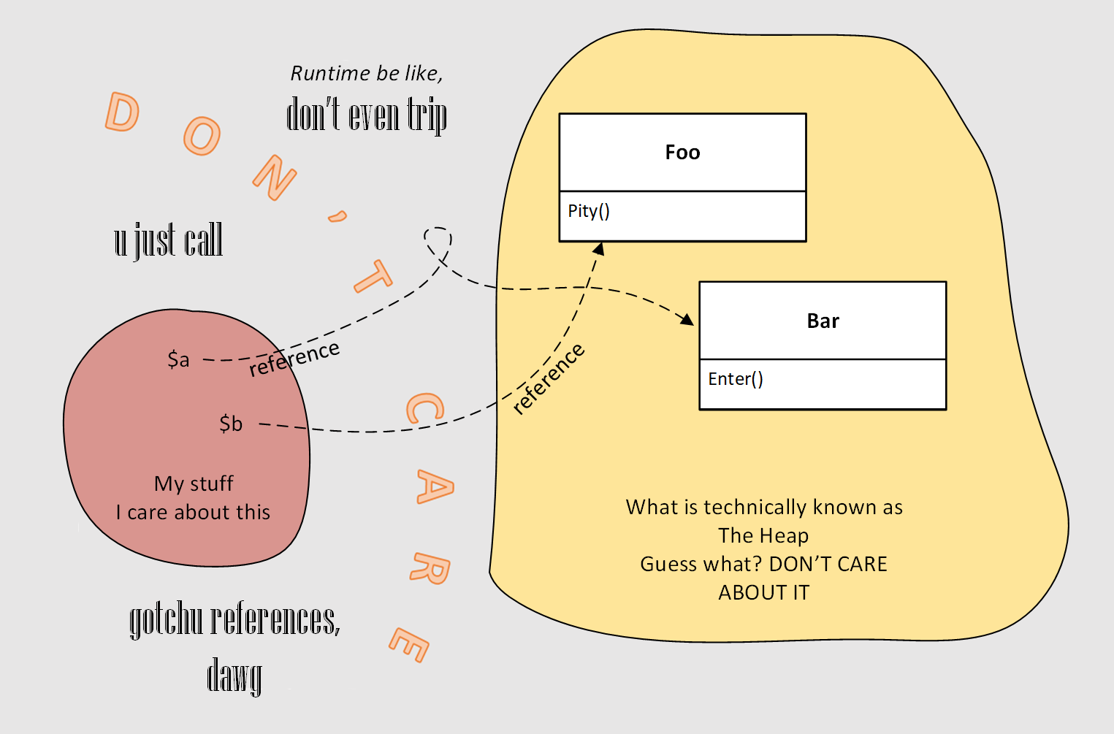
Memory managed objects
Notes:
Nowadays, we use languages that provide memory management. You don’t care about memory addresses.
Instead of pointers, you have references. The runtime sorts out where the actual pointers are. I’m showing you this graphic, but you literally don’t care, because you can store something and get it back without thinking any more about it.

Slide 7
Java / C#
Completely memory managed - runtime handles pointers, programmers never touch them
Object-oriented (but allow procedural programming)
Introduce encapsulation: private, protected modifiers
Compiled: compiler checks syntax and static typing
Notes:
Does anyone here regularly think about deallocating memory? If so, how do you accomplish it? (Or – No, you don’t have to) Yep – drop the reference and walk away. Java and C# have garbage collectors.
This is achieved because these languages are not compiled to machine code – they are compiled into an intermediate code which runs in a runtime engine. The runtime engine provides memory management. A compiler COULD insert subroutines for this and compile to machine code – but that’s not how Sun and Microsoft designed the languages.
Memory management tag-teams with scopes. In C, a memory allocation exists until it is manually deallocated. In C#, a variable exists until it falls out of scope. Typical scopes are instance-scoped – an object’s data dies with the object – and method-scoped – a variable ceases to exist when the enclosing method returns. This makes it much easier to avoid memory leaks.
In Java and C#, references are strongly-typed. If you declare a variable as a string, no bug can make it not-a-string. The code won’t compile if you try to make it something else. (Sometimes you can get this to compile, but it will throw at runtime.)
Java and C# are object-oriented. Instead of executing sequence of statements, including passing data into procedures, you primarily define objects and make them interact with each other. An object is one or both of state (data) and behaviour.

Slide 8
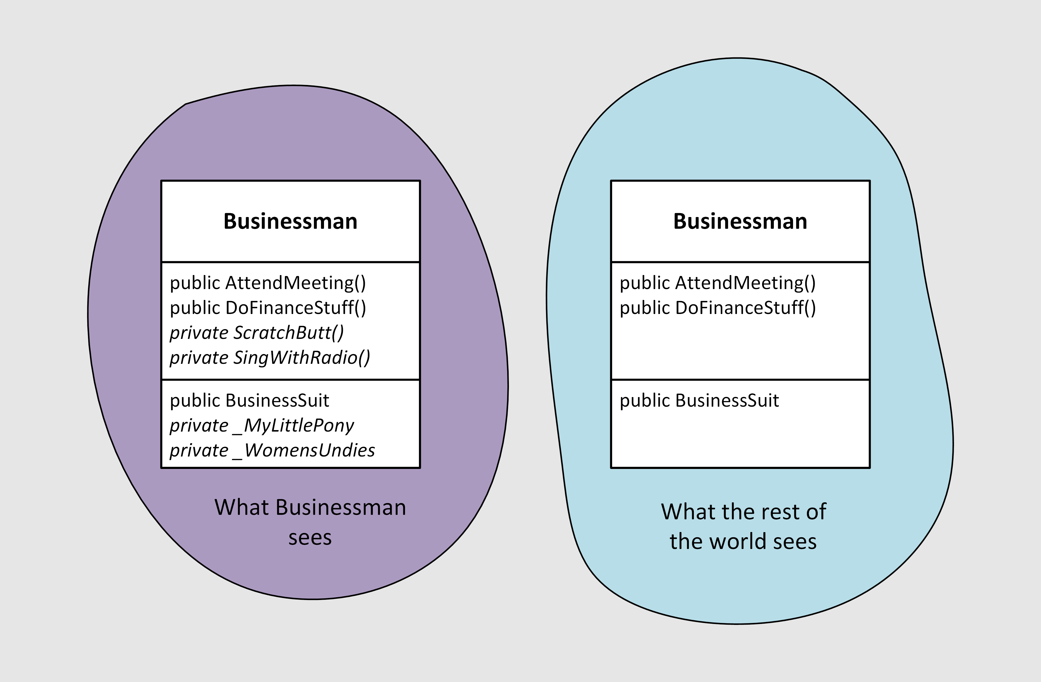
Access modifiers
Notes:
Members of a class can be declared public or private. This makes them visible or invisible outside the object. What you can see of and do with the object is restricted.
As long as he does the finance stuff, it’s no business of anyone else what Businessman chooses to spend his money on.
Even if it’s not a traditionally masculine toy.
And it’s only £19.99 at Toys’R’Us.
And he still has his Christmas money to spend.
And Aunt Jean told him he could SPEND IT ON WHATEVER HE WANTED, DAMMIT!
But by making our choice of toy private, we give ourselves the flexibility to change it later, if we decide we want to move from My Little Pony to Furbies.
We also make it easier for other devs to use our code, by removing options that aren’t helpful. It would be frustrating for a developer to spend half an hour flicking through an underwear catalogue only to find out that setting the underwear to something with frills does not have the desired effect on the Finance Stuff.
We say that the interface of BusinessMan defines AttendMeeting(), DoFinanceStuff() and BusinessSuit. And now we can look at our first principle…

Slide 9
Code to an interface, not an implementation
Get in the mindset of interacting only through carefully-designed interfaces
Notes:
Anything you expose from any entity forms an interface. An interface forms a contract with the world – if you only access these members, I will keep the behaviour consistent.
All the rest of it is internal mechanism – and that means that you can change it any time you want. And this doesn’t just mean changing how the object works under the hood – it might mean swapping the object out for another one that implements the same interface.
If you take the covers off and access the mechanism directly, it serves you right if you get your fingers jammed. Some of that underwear is really tight.
The flip side of this is that, when we write code that others will interface with, we should think carefully about what our interface should expose, because that’s what we don’t want to go changing later.
It’s all about the interfaces. Get the interface right, and you have your design. Get it wrong, and you’ll be fighting it further down the line.
In Java and C#, interfaces are first-class citizens and have their own keyword. In Powershell, this principle mainly applies to:
what you export from a module
what you accept in a parameter block
what you return from a function
to a lesser extent, what members of a class you mark as “hidden”
All of this is dynamic. You can’t enforce a return type from a function.
In Powershell classes, you also cannot - strictly speaking - define an interface or a private member. But I’ll show you how to fudge that later.

Slide 10
DSC / YAML / SQL
Declarative
Syntax is very constrained – you don’t think about design
Except SQL, which you can hear about in some other talk!
Notes:
Honourable mention – the “declarative” paradigm. You define the input state, and set the machine going. You do not write statements to be executed in sequence.

Slide 11
LISP / R / F#
No mutable values! Eliminates bugs caused by something being changed when you don't expect it to have been
A function is an operation that maps a domain of input values to a range of output values
That’s about it, but it turns out to be sufficient to write applications
Problem: converts are a little bit too zealous.
Notes:
Functional programming is a subset of declarative programming in which, unlike YAML, you also declare the functions that work on the data.
It’s still not about executing statements in order – it’s about mapping input to output.
But I won’t go into this because it’s extremely tangential to powershell!

Slide 12
Procedural vs OOP
Procedural:
Principal control mechanism: loops and conditionals
No strong concept of access control (private members)
OOP:
Principal control mechanism is polymorphism
Stuff can be private: strong concept of interfaces
Notes:
In software, you have to model the problems that you want to solve.
OOP has become the dominant paradigm for because modelling components as objects with state and behaviour lets you think at a higher level about the problems you need to solve. The code becomes more readable.
I’d better explain what “polymorphism” means: it is the idea that you can swap objects to change behaviour. For example, .NET provides a number of StreamReaders in the base class library (BCL). You have MemoryStreamReaders, FileStreamReaders, TcpStreamReaders, XmlStreamReaders. All of these provide a unified way to get the data.
If we swap a FileStreamReader out for a network protocol streamreader, we are changing behaviour using polymorphism.
In Java and C#, a requirement for this to work is that all the possible objects implement the same interface. So, if you hold something with that interface type, the actual object could take many forms. Languages like Python and Powershell aren’t this strict.
I’ll be coming back to this later.

Slide 13
…Powershell
Primarily used as a procedural language (define functions and pass in data)
Can use as OO language
Custom objects
Classes in PSv5
Inline C# in any version
Use existing .NET objects
Import-Module –AsCustomObject
Weakly-typed, but you can constrain (no compiler help tho!)
Dynamically-typed
Scoped and memory-managed
Notes:
About the weak typing – you absolutely can blow up your code by trying to do string things to a WMI object, for example. There is no compiler stage in the development process to catch type errors. The best you get is IntelliSense suggestions.
You can declare a variable as a particular type – e.g. in param blocks – but this is runtime checking and all it means is you get a helpful exception immediately instead of a weird one later.
This may be a good time to warn you all that “Powershell” and “Software architecture” are not commonly mentioned in the same breath, and that’s because the dynamic nature of them give you less help as a software architect.
In fact, I’m giving this talk because there’s been very little written about software engineering in Powershell. And some of what I’m going to show you is a bit of a hack, because the language doesn’t naturally support a strongly-defined architecture. I’ve come to believe that Powershell is not inherently a good choice for complex projects. The reason we’re sitting here is because Powershell works for us and we know it, and one of the reasons for choosing a particular language is whether your team has skills in the language. Therefore, applications are going to get built in Powershell, and that’s why I want to get my thoughts out on how to engineer software in it.

Slide 14
Software Engineering
Changing requirements
Reqs not initially clear
Write software that supports future change
Notes:
Software Engineering is a profession that is primarily concerned with change.
New acquisitions
Regulatory change, business process change
New apps and providers
If you’re a developer, you can write something that works – but an engineer has to write something that is also evolvable
“Evolvability” implies more direction than just “change” – it suggests that you have an architecture at the beginning and, two or three years on, you still have an architecture. It may not be the same architecture, but there is still coherence to the product.
If we are writing projects of some size and we do not concern ourselves with the practice of SE, we are in danger of ending up, either initially or after a few years’ worth of change, with spaghetti code, where further change becomes expensive and demoralising.

Slide 15
Repeated code
Diagram of API pulling form github, build process pulling form github
Notes:
I support an app that runs scripts form a library on target machines.
Each script may import a couple of modules, and each of those modules may import a couple more. Our top offender imports 13 modules and our top import depth is 5. We also pin dependencies to specific versions. I work a lot with module dependencies.
<cut to Code showing RequiredModules in a .psd1 and to Get-ModuleDependency>
We distribute modules from github releases. The execution engine only cares about getting the modules and importing them in an order that means the lowest dependencies are importing them first. SO it pulls artifacts form the release, inspects the psd1, gets the next module, and so on. As it goes, it accumulates modules into a list which it then reverses to get a viable import order.
Our peer review process involves inspecting the dependency tree. For this, we only want to see the versions and names, so the PR code just pulls the .psd1 from the commit that’s tagged by the release. As it proceeds, it keeps track of how many levels down it is, and writes to the console with indentation according to the tree structure.
We have two separate solutions, and we have other old ones lying unused in our codebase.

Slide 16
Don’t Repeat Yourself (DRY)
If you’re repeating a lot of code, it’s a sign that you’re doing it wrong!

Slide 17
Refactoring
The process of changing code, without changing the functionality, to make it better organised
Notes:
Our finance team is starting to get aggressive about stripping Github licenses away. Our users complain that they can no longer download our modules.
We would like to move to nuget for module distribution, but we can’t, because we would have to throw out our solutions.
The change is too expensive.
We need a solution that works with Github or with Artifactory, and that works to download modules, get the import order, and display it.
The slide says “refactoring” but, to be honest, we’re going to completely rewrite and just change the client code. But our goal is to have one solution that works in Github, then we’re going to make it support nuget as well.
To achieve this, we’re going to follow the principle of Separation Of Concerns.

Slide 18
Separation Of Concerns
An object (or function) should only do one thing
Notes:
We need to separate the code that access Github from the code that understands and formats module dependencies.
<cut to Code showing simplified current solution>
At the moment, we’re not really modelling the dependency. We’re just running loops, and invoking Github in the loops.
To make our code concise in OOP, we should make it reflect the problem we’re modelling. Straightaway we can see that recursion is a better fit for working with a tree than looping, if we want to work in a procedural fashion.
But we can do better with OOP. What is a tree?
It’s a collection of nodes
With a directional relationship
In module dependencies, there’s no distinction between branch and leaf nodes. So every node is the same class of object.
Every node represents a module and has one parent (or none for the first module) and one, none or many children. So we’re going to represent the module, and then add a single object reference to the parent, and a list of references to the children, and these references are going to be of the same type as the object itself.
And we are going to follow the Liskov Substitution Principle…

Slide 19
Liskov Substitution Principle
Any object should be possible to substitute with a subclass of itself (you can use a subclass in place of a base class)
Notes:
We are going to extend an existing class. This means that we can do all the same things with our new tree that we might do with that existing class, so let’s pick a useful class to extend.
What existing class shall we use?
_PSModuleInfo_?
Possibly, but I’ve settled on a ModuleSpecification object.
ModuleSpecification is the native object of psd1 files. Where you have a RequiredModules property containing a string name or a hashtable spec, the powershell engine converts those to ModuleSpecification.
<Cut to code showing class def for ModuleSpecification>
It defines:
Name
Guid
Version info
So that’s our starting point.
Leading to our next principle:

Slide 20
ModuleSpec
First stab at a module dependency tree
Notes:
Cut to code showing ModuleSpec class extending ModuleSpecification
Chain base class ctors
Function Get-ModuleDependency pastes in mock module specs Human / Cow / Grass / Pig / Truffle
Implement PrintTree()

Slide 21
ModuleFetcher
A class hierarchy for downloading modules that meet a module spec
Notes:
Place ModuleFetcher in Get-ModuleDependency and move mock modules into it (SOC) (GMD is only concerned with building module trees and shouldn’t also know about how to fetch modules)
Separate MockModuleFetcher out and make ModuleFetcher a base class
Implement FileSystemModuleFetcher
Get-ModuleDependency has switches for Mock or FileSystem (using an if/else)
This implements Strategy pattern

Slide 22
Strategy pattern
An object’s behaviour doesn’t come from itself, but from another object that the first object has. The Strategy object can be replaced with another to change behaviour.
Notes:
Note that The ModuleFetcher base class defines an interface, that means that we always can rely on the Fetch() method.
We have gained a lot of freedom to change this object (Get-ModuleDependency). We assessed what might change, and structured the code to make that change easy.
But there’s still a slight problem!
Change switch if/else to if/elseif/else {throw NotImplemented}
This object still controls what strategies we can use. The control is not with the client. To be fair it is not difficult to change a Powershell function, but it would be nice to be able to swap in behaviour without making any changes at all. So we are going to use Dependency Injection.

Slide 23
Dependency Injection (DI) pattern aka Inversion Of Control (IOC)
Objects or services that an object needs are provided to it by a client. This gives control back to the client.
Often found with the Strategy pattern.
Notes:
Get-ModuleDependency now takes ModuleFetcher as parameter. Abolish switches.
We now can pass in a mock or a real module fetcher, and we have complete freedom to implement a github module fetcher.
Let’s pause before we do that, because we’re not at Minimum Viable Product yet. We need to implement .Import().
Oh noes! It doesn’t work! Why is that? Version mismatch. One of our module requirements is version pinned, and we have imported a higher version.
Implement Equals()
Now we can tell when a modulespec we’ve found really meets our spec. But we need to work with PSModuleInfo.
ModuleSpecification is also possible to access from a PSModuleInfo object. However, it’s not a public property. So we are going to need to use reflection to access that private data. This breaks our first principle, which was? Code to an interface, not an implementation. So our next principle is…

Slide 24
They’re more like guidelines…
You can break a principle if you have a good reason
Notes:
PSModuleInfo is fixed because it’s what we get from Import-Module, Test-ModuleManifest etc. But we really want those specs hidden in that private field. So we are going to take a gamble that Microsoft won’t change the implementation, and we’re going to code to the implementation, not the interface.
<Implement reflection>
OK, now we can import a tree of modules.
Next thing, I don’t like that the module tree is responsible for printing itself.
Replace PrintTree() with Depth property and GetDepth(), and Format.ps1xml (SOC)

Slide 25
Further reading
https://dfinke.github.io/powershell,%20design%20patterns/2018/04/13/PowerShell-And-Design-Patterns.html
https://www.automatedops.com/blog/2018/04/11/software-design-patterns-in-powershell-strategy-pattern/
Martin Fowler – Patterns Of Enterprise Application Architecture
https://blog.dustyfox.uk

